Slide 1

Solutions Engineer Interview Exercise
David J. Levine
Solutions Engineer Candidate

Slide 2
Overview of the Project
Task 1: Vision
Configure a basic camera component and use Viam’s vision service to implement a simple object detector
Task 2: Cloud Integration
Configure Viam’s data capture service to store camera frames into the cloud
How could we use this data to possibly create a custom model?
Task 3: Modular Registry
Create a custom sensor (calling the previously created vision service)
Should have a single field called “person detected”
Set to 1 if a person is detected, and 0 if no person is detected

Slide 3
Platform architecture: highlights
CLOUD
Manages machine config, API access for SDK scripts
App.viam.com
Cloud storage
Smart machine part:
david-macbook-main
viam-server
Webcam:
(“cam“)
ML Model
”people”
EfficientDet-COCO
Vision Service:
“myPeopleDetector”
Calls “people”
Custom software module:
“sensor-pd“
Custom sensor-1 component:
Uses custom module “sensor-pd“
Python SDK Scripts (runs locally)
Notes:
The diagram shows how the different parts of Viam work together
My local Python SDK script communicates with the Viam Cloud using an API key, which then routes to the local viam-server
The camera feed is processed through the EfficientDet ML model (people)
The Vision service (myPeopleDetector) wraps this and provides a simple detection interface
All components are configured via the Viam UI, no manual JSON was needed for setup
The JSON configuration reflects this architecture and was auto-generated by the platform
“The local component sensor-1 is an instance of the model dl-org:sensor-pd:pdetect, which is defined in my custom module sensor-pd.”
Here’s how that breaks down:
Module: sensor-pd – This is the local Python module you developed.
Model: dl-org:sensor-pd:pdetect – The unique identifier for the person detection sensor logic.
Component: sensor-1 – The actual, running instance of the sensor on your local Viam machine.

Slide 4
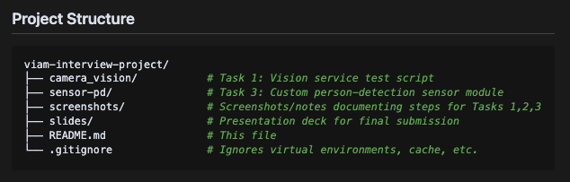
Overview of the Project Directory
From GitHub README: https://github.com/djlev8/viam-interview-project/tree/main
From Viam dashboard

Slide 5
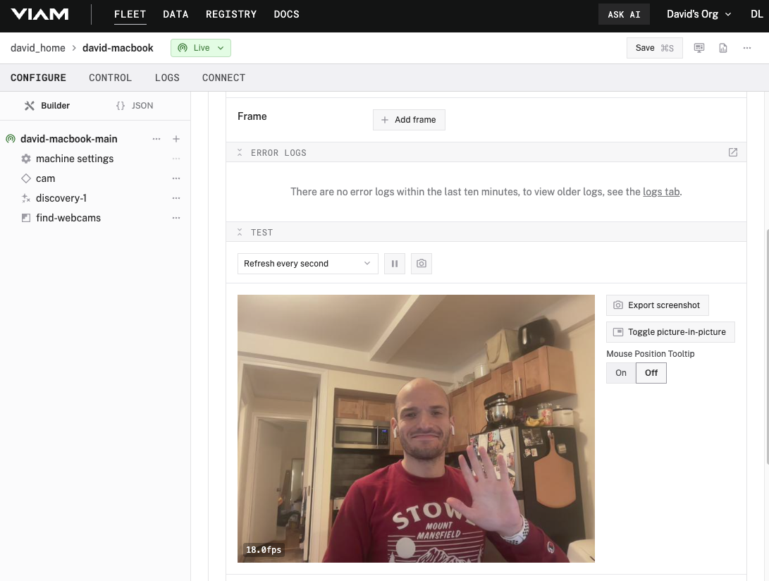
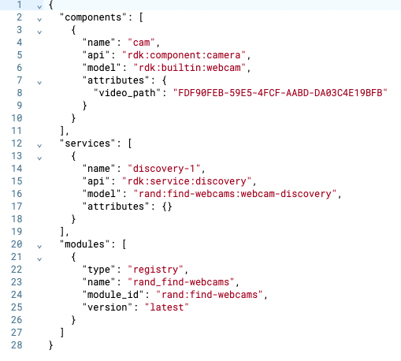
Task 1: Vision Service and Object Detection
Following the ‘Detect a Person and Send a Photo’ tutorial.
Goal: Set up a webcam → ML model (EfficientDet-COCO) → Vision Service → SDK-based person detection
Configured webcam test
Configured webcam JSON
Notes:
I first created a new machine called david-macbook-main, and then configured a webcam component
I used a discovery service to find the correct video_path for my built-in camera, since it did not come up automatically
Here you see the configured camera, showing its view of me once a second.

Slide 6
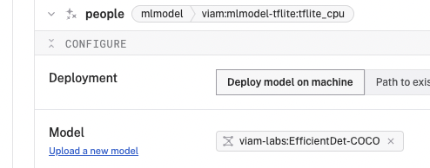
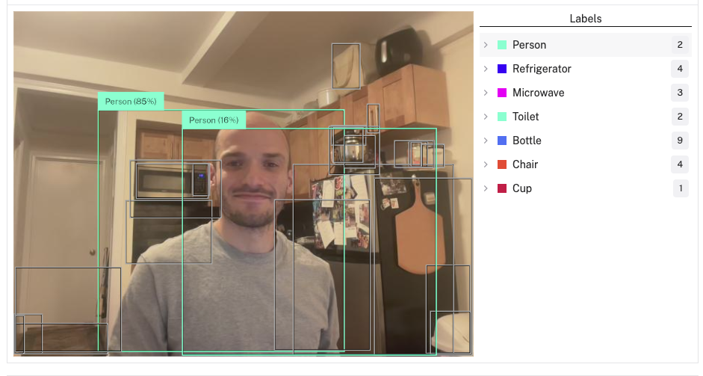
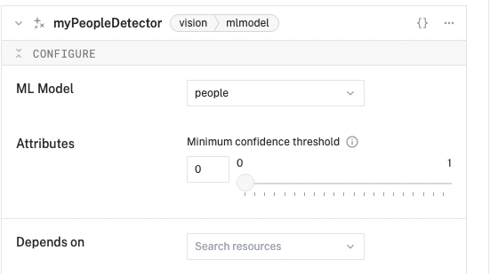
Task 1: Vision Service and Object Detection
Goal: Set up a webcam → ML model (EfficientDet-COCO) → Vision Service → SDK-based person detection
EfficientDet-COCO model deployed
Detection UI
Vision Service created and linked to model
Notes:
The camera feed is processed through the EfficientDet ML-COCO model (people) from viam-labs
The Vision service (myPeopleDetector) wraps this and provides a simple detection interface
All components are configured via the Viam UI, no manual JSON was needed for setup
The JSON configuration reflects this architecture and was auto-generated by the platform

Slide 7
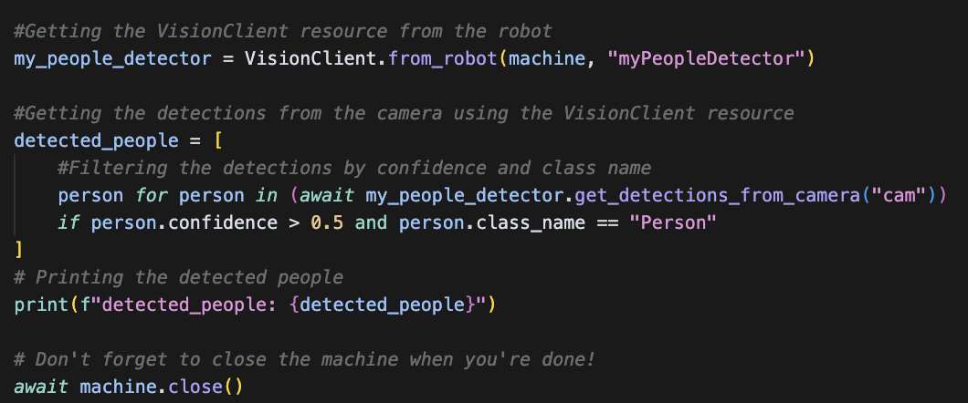
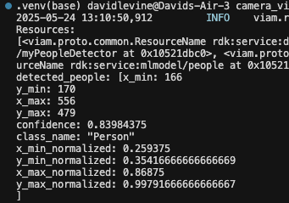
Task 1: Vision Service and Object Detection
Goal: Set up a webcam → ML model (EfficientDet-COCO) → Vision Service → SDK-based person detection
Code snippet from detection script (vision_service.py)
Terminal Output: Person Detected
Used SDK to filter for confident (> 0.5) ‘Person’ detections, instead of printing all detections found, regardless of class name or confidence
Notes:
🔍 What I Did in the Script:
Connected to my smart machine using RobotClient and a secure API key:
Even though the script runs locally, it connects via the cloud to route securely to my local viam-server.
This mirrors how customers would interact with remote robots.
Loaded key Viam components:
Camera: Accessed live video feed from my MacBook’s webcam (cam)
MLModel: Loaded metadata about the deployed EfficientDet-COCO model (people)
Vision Service: Used myPeopleDetector to interpret results from the model
Filtered detections using the SDK:
Called get_detections_from_camera("cam")
Applied logic to only keep detections where:
confidence > 0.5
class_name == "Person" (case-sensitive match to model output)
Printed filtered detections to verify successful pipeline from:
Camera → ML Model → Vision Service → SDK
Closed the robot client to clean up the connection properly.
Many key methods in the Python SDK are async def, including:
await connect() or await connect_with_channel() – connects to the robot
await camera.get_image() – fetches an image from a camera
await vision.get_detections_from_camera() – gets vision detections
await robot.close() – shuts down the connection
So any time you’re using those methods, your function must be async def, and you must use await to call them.
Async allows your script to:
Avoid blocking while waiting for data from a camera or vision service
Handle multiple I/O operations concurrently (e.g., processing detections and saving results)
Scale efficiently, especially if you build a larger app or server around it

Slide 8
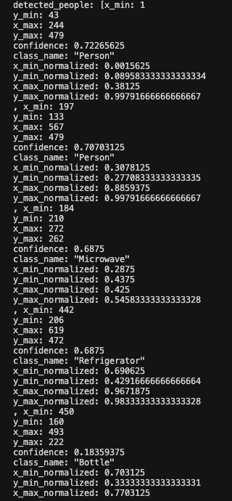
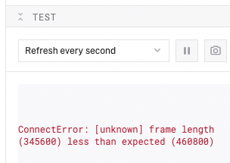
Task 1: Vision Service and Object Detection
Challenges & Debugging:
Encountered webcam connection error
Restarted viam-server and reconnected successfully
CLI: viam-server -config ~/Downloads/viam-david-macbook-main.json
Needed to use discovery service to retrieve valid video path for my built-in webcam
Filtered through list of detections to find confident ‘Person’ only detections after first obtaining all detections
Webcam connect error
Initial output: Detecting many objects
Notes:
Original code:
detected_people = await people_detector.get_detections_from_camera("cam")
print("peopleDetetctor get_detections_from_camera return value: {detected_people}")
Changed to: detected_people = [
person for person in (await my_people_detector.get_detections_from_camera("cam"))
if person.confidence > 0.5 and person.class_name == "Person"
]
print(f"detected_people: {detected_people}")

Slide 9
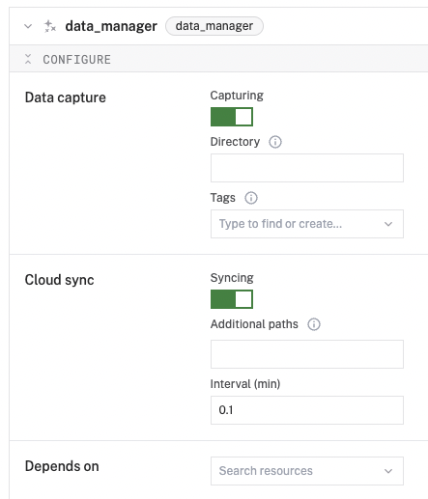
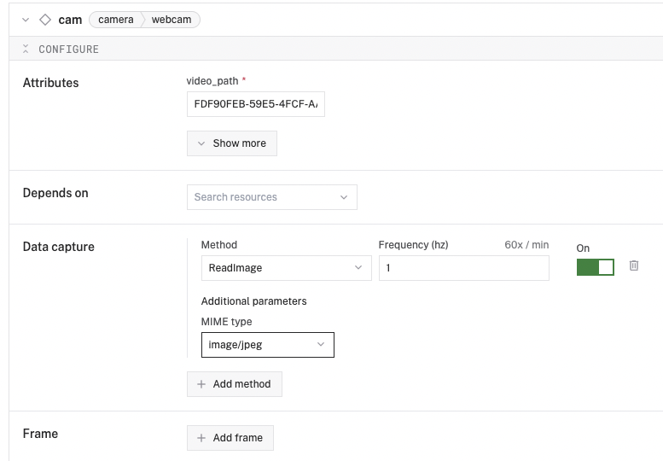
Task 2: Data Capture & Cloud Storage
Following the ‘Capture and sync edge data’ document.
Goal: Create data-manager service → Set capture rate & ReadImage method → Store frames to cloud
Data capture settings specified (capture rate = 1 Hz, MIME type = JPG)
Data management service enabled
Note: Needed to create data management service prior to configuring data capture with configured camera.

Slide 10
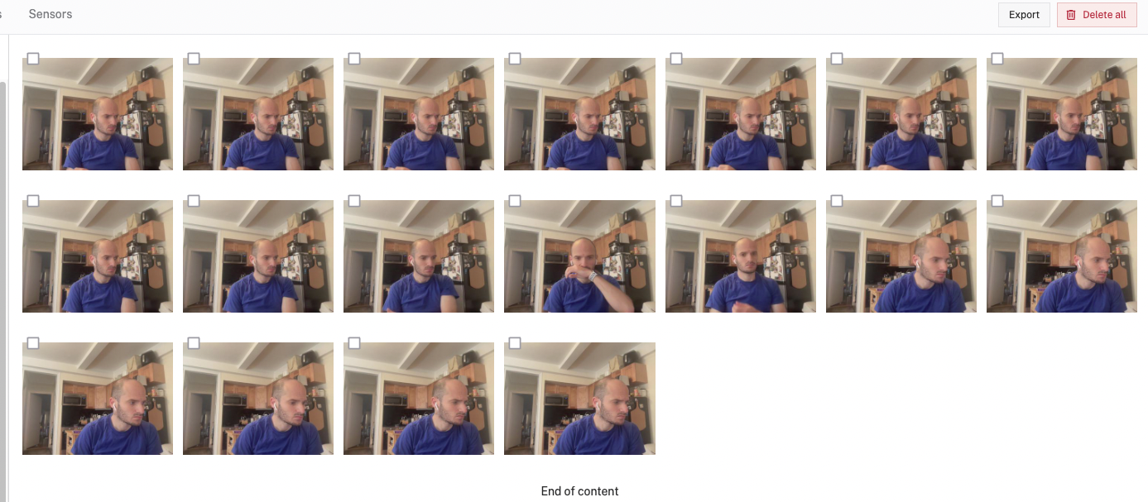
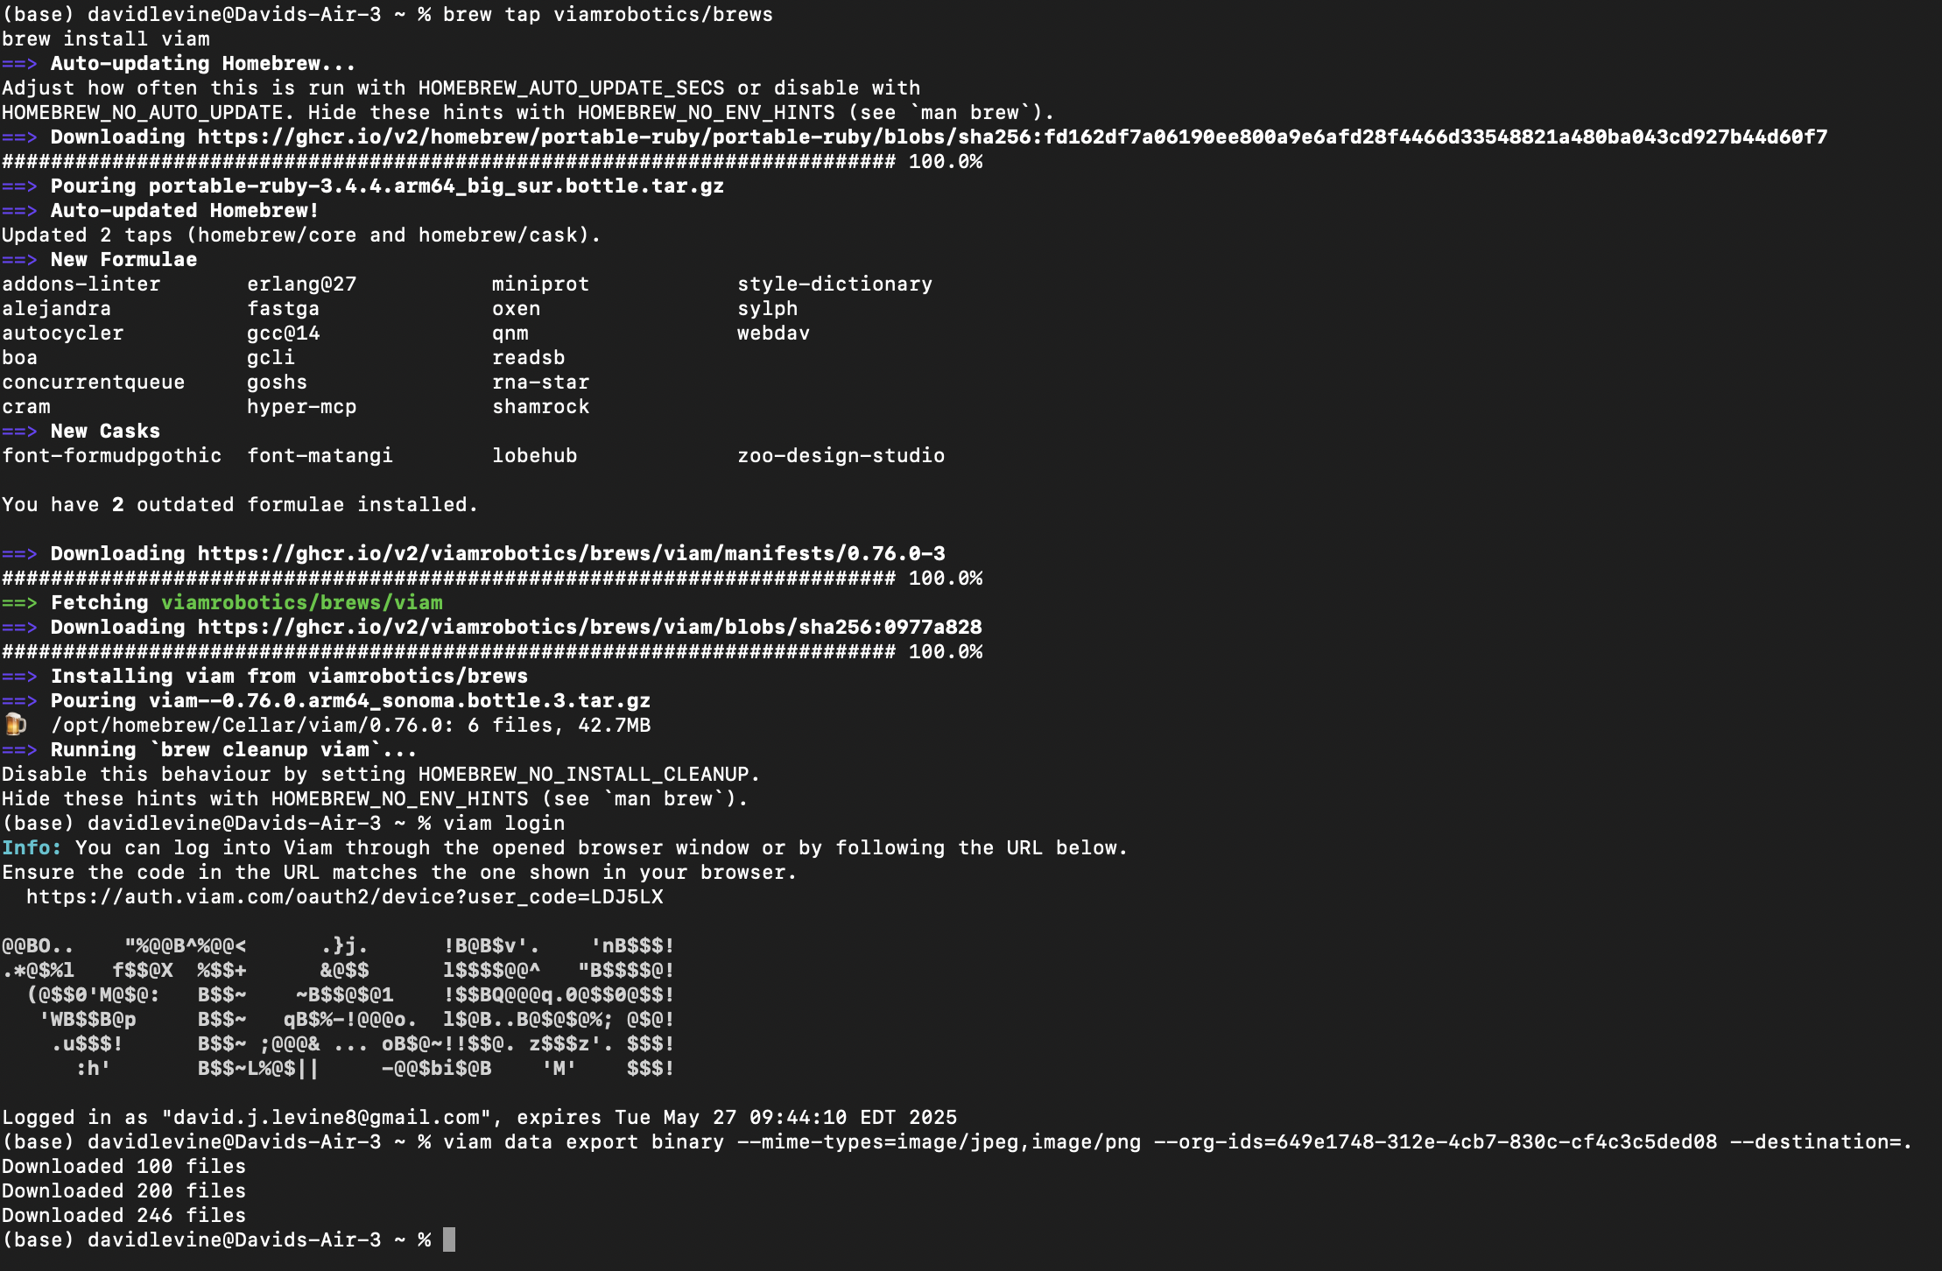
Task 2: Data Capture & Cloud Storage
Goal: Create data-manager service → Set capture rate & ReadImage method → Store frames to cloud
Images stored to the cloud
Installed viam CLI to run image export
Notes:
viam data export binary --mime-type=image/jpeg.image/png –org-ids=<ORG-ID> --destination =.

Slide 11
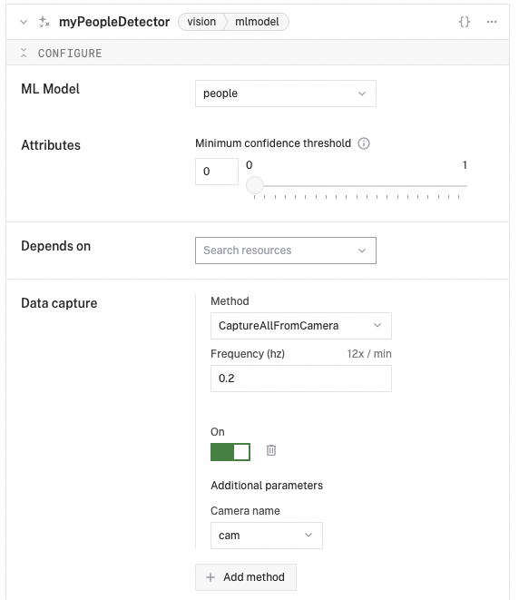
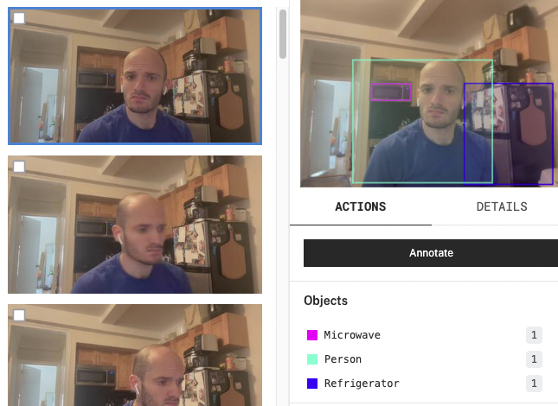
Task 2: Data Capture & Cloud Storage
Goal: Create data-manager service → Set capture rate & ReadImage method → Store frames to cloud
Images stored to the cloud with detection details from myPeopleDetector Vision service

Slide 12
Task 2: Discussion – How the data enables custom models
This type of captured image data is valuable for:
Evaluating model accuracy: comparing what the model detects vs what’s actually in the frame.
Labeling custom datasets: using stored images and metadata to label people or other objects (annotate within Viam).
Retraining or fine-tuning models: creating a customer-specific version of EfficientDet-COCO that performs better on their environment or edge cases (varying lighting, backgrounds, angles).
Exported image data and detection logs can be used to train or validate models in frameworks like PyTorch, TensorFlow, or AutoML pipelines.
Going forward, combining image data with detection metadata (e.g., bounding boxes + class + confidence) provides a complete training set for a custom object detector.
Notes:
https://python.viam.dev/examples/example.html
To do this programmatically: from viam.components.camera import Camera
from viam.media.video import CameraMimeType
from viam.media.utils.pil import viam_to_pil_image
robot = await connect_with_channel()
camera = Camera.from_robot(robot, "camera0")
image = await camera.get_image(CameraMimeType.JPEG)
pil = viam_to_pil_image(image)
pil.save("foo.png")
# Don't forget to close the robot when you're done!
await robot.close()
Once I export image frames and detection results, I could use them to fine-tune a detection model in PyTorch or TensorFlow. This would improve accuracy over time — especially for edge deployments where lighting and camera angles vary. I could even automate retraining with AutoML tools.
Tool
PyTorch
Open-source deep learning framework by Meta (Facebook)
Custom ML models, fast prototyping, GPU acceleration
TensorFlow
Deep learning framework by Google
Production-ready ML pipelines, especially for edge
AutoML
Tools (like Google AutoML or AWS SageMaker Autopilot) that automate model training
Great for non-experts or rapid iteration
Exporting image data and detection logs from your Viam module lets you:
✅ Train better object detection models over time.
✅ Fine-tune confidence thresholds or improve accuracy in new environments.
✅ Run ML pipelines that automatically retrain and redeploy models on edge devices.
✅ Enable continuous improvement — essential for real-world deployments where lighting, angles, and backgrounds vary.
Viam’s modular architecture and data capture service are designed to make this ML ops pipeline easy.

Slide 13
Task 3: Modular Registry: Overview
Following the ‘Integrate other physical or virtual hardware’ document.
Goal: Build a custom sensor module that uses the Vision service I previously created and returns:
{’person_detected’: 1} if a person is visible to the camera,
and
{’person_detected’: 0} if a person is NOT visible to the camera.
Steps:
1) Module Setup
2) Module Implementation
3) Adding the Custom Sensor Component to my Machine
4) Local Testing
5) Error Handling & Fixes

Slide 14
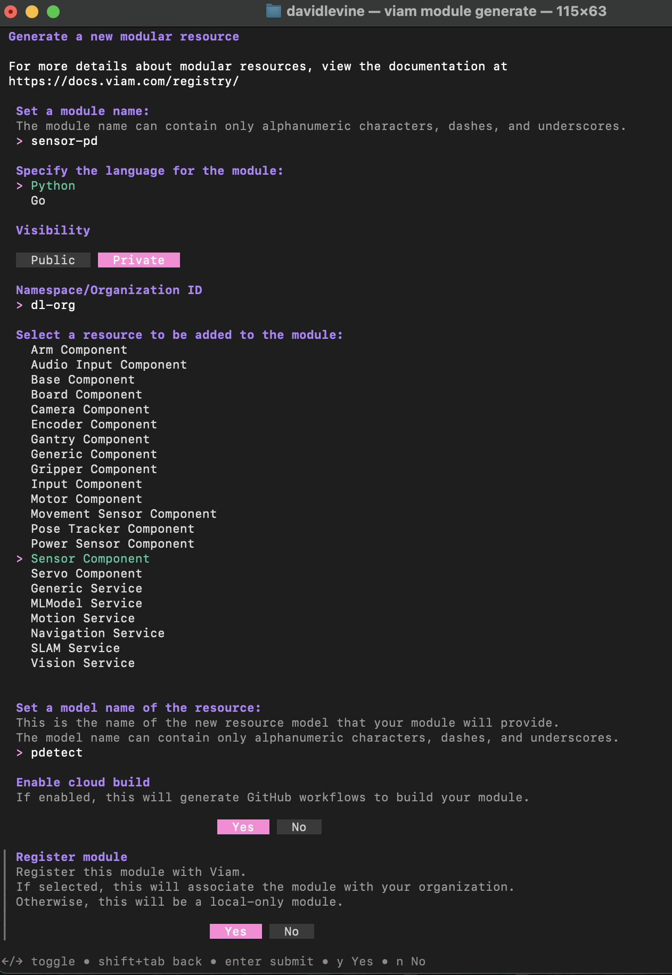
Task 3: Modular Registry: Module Setup
Goal: Scaffold and generate the custom module, generating the necessary stub files (in the sensor-pd folder).
Module successfully generated!
Prompts filled:
Name: sensor-pd
Language: Python
Visibility: Private
Namespace/Org-ID: dl-org
Resource to be added: Sensor Component
Model name: pdetect
Cloud build? Yes
Register module? Yes
From the CLI, I used viam module generate and followed the relevant prompts.
Notes:
Terminal command used to scaffold a new custom Viam sensor module named `sensor-pd`, specifying Python as the language, setting it as private, and registering it under the `dl-org` namespace.
Confirmation message from the Viam CLI showing successful creation of the module folder structure and initialization of boilerplate code.

Slide 15
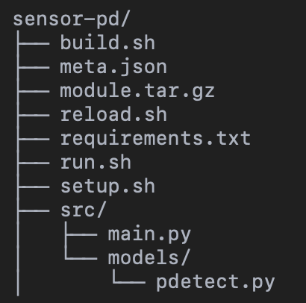
Task 3: Modular Registry: Module Setup
Goal: Scaffold and generate the custom module, generating the necessary stub files (in the sensor-pd folder).
Final file structure within the generated sensor-pd folder:
I added or changed files from the auto-generated structure to implement my custom sensor logic and enable local development and testing:
reload.sh (I added)
Script I wrote for hot reloading the module locally.
meta.json (I modified)
src/models/pdetect.py (I modified)
src/main.py (I modified)
Notes:
sensor-pd/
🔹
build.sh
Used for cloud builds (optional).
A shell script used to automate the packaging of your module into a .tar.gz file. While optional in local development, it’s useful if you later want to deploy your module via cloud builds on Viam.
🔹
meta.json
Module manifest file.
Describes your module to Viam. It contains:
entrypoint: The script to run the module (e.g., reload.sh).
build: Instructions for packaging and building your module.
model: The namespace triplet (dl-org:sensor-pd:pdetect) that describes the model your component implements.
arch: Architectures the module supports (linux/amd64, etc.).
🔹
module.tar.gz
Packaged version of your module.
Automatically created during build. This archive contains all code, configs, and scripts needed for your module to run on the Viam RDK.
🔹
reload.sh
Hot-reload entrypoint for local development.
Executes setup and then launches main.py. Used during viam module reload --local to allow rapid iteration without cloud build.
🔹
requirements.txt
Python dependencies.
Specifies the Python packages required to run the module, including viam-sdk. Installed during setup via setup.sh.
🔹
run.sh
Optional script for local testing.
Often used as a convenience script to run the module without Viam’s tooling. You may use this to simulate startup locally outside of the Viam UI.
🔹
setup.sh
Sets up a virtual environment.
Creates a .venv, installs dependencies from requirements.txt, and prepares your environment for development and testing.
sensor-pd/src/
🔹
main.py
Module startup script.
Registers your custom model (dl-org:sensor-pd:pdetect) and launches the module. This is where your resource is added to Viam’s registry and your component gets connected to the machine.
sensor-pd/src/models/
🔹
pdetect.py
Your custom sensor implementation.
Defines the Pdetect class, a sensor that wraps a Vision service to detect people in a camera feed. It includes:
validate_config(): Checks that the camera name and dependencies are set.
reconfigure(): Dynamically updates the component config.
do_command(): Calls the Vision service to check for people.
get_readings(): Wraps do_command() and exposes a binary result.

Slide 16
Module Architecture: How Viam Registers and Runs the Custom Sensor
viam-server automatically launches the module when the smart machine boots.
For local testing, I used reload.sh to call main.py.
The module (your code) is registered using Module.from_args()in main.py.
The custom model dl-org:sensor-pd:pdetect is registered to point to the Pdetect class in pdetect.py.
When a modular resource is created (e.g. sensor-1), the following flow happens:
validate_config() checks for required attributes (camera_name, detector_name) and declares dependencies.
new() instantiates the Pdetect class and calls reconfigure().
reconfigure() receives a dependency map and retrieves the Vision service using the user-supplied detector name.
That Vision service is stored internally to enable live detection in do_command.
The sensor is now live. The Viam app can call get_readings() → do_command()to check if a person is detected.
Logs and live values are visible in the Viam UI for easy debugging.
Notes:
How Viam runs my module: When the machine boots, viam-server launches the module binary based on the declared path and models. The module registers its resources, and for each component instance, validate_config() is called to ensure the config is valid. Then new() and reconfigure() are invoked to build and initialize the resource with its runtime settings and dependencies.

Slide 17
Task 3: Modular Registry: Module Implementation
Goal: Add custom logic to Pdetect class (pdetect.py) to execute the goals of Task 3. Following the docs & looking at the ‘simple-module’ example in the Viam Python SDK, I had to make sure I edited the following within Pdetect:
new()
validate_config()
get_readings()
reconfigure()
do_command()
Notes:
Edit the validate_config function to do the following:
Check that the user has configured required attributes and return errors if they are missing.
Return a map of any dependencies.

Slide 18
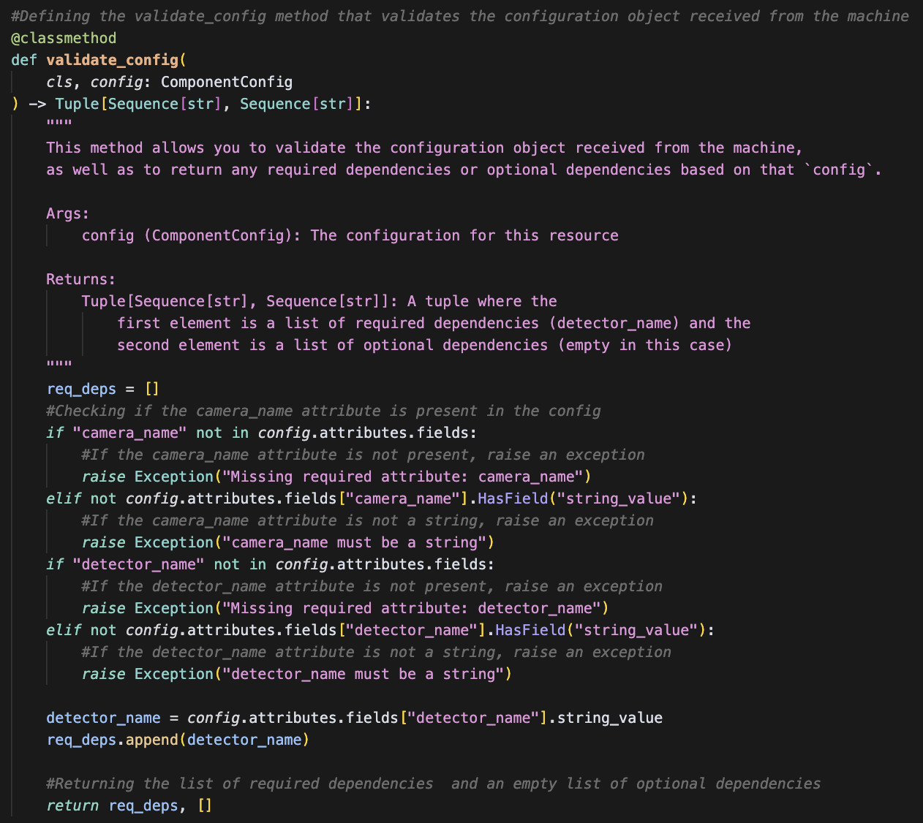
Task 3: Modular Registry: Implement the Component API
validate_config():
Ensures that the user-supplied configuration is valid before the module is started.
Checks for required attributes: camera_name (required attribute) and detector_name (required attribute & dependency)
Raises errors if required fields are missing or improperly typed
Declares required and optional dependencies for the module.
Dependencies returned: required: detector_name
This tells Viam to pass in the Vision service resource with this name at runtime.
Notes:
Edit the validate_config function to do the following:
Check that the user has configured required attributes and return errors if they are missing.
Return a map of any dependencies.
Prevents runtime failures by enforcing configuration rules up front.
Allows Viam to wire up resource dependencies automatically (like linking to a vision service).
Note:
camera_name is a required attribute because it’s just a string used to route the vision query to the correct camera.
detector_name is a required dependency, since our module needs access to the actual Vision service object to perform detection.
Need required dependency – need to inject in reconfigure.

Slide 19
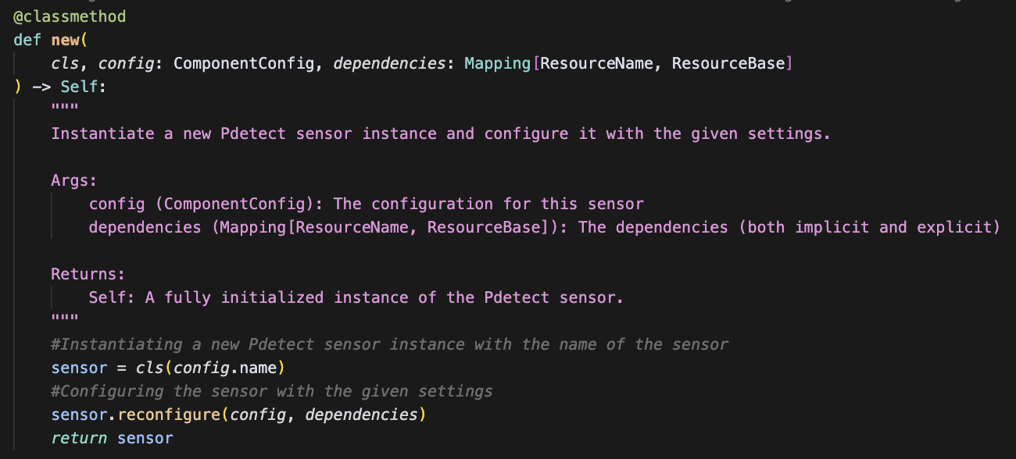
Task 3: Modular Registry: Implement the Component API
new():
This method is responsible for creating and returning a new instance of the Pdetect sensor class.
It receives the config and dependencies from the Viam system.
It initializes the sensor (sensor = cls(config.name)) and then immediately calls reconfigure() to apply the configuration and wire up dependencies.
It returns the fully ready-to-use sensor instance.
Notes:
The new() method is a class method used to instantiate the custom sensor when the module is initialized by Viam. It reates a new instance of the Pdetect class using the name from the component’s configuration.
Calls reconfigure() to initialize any attributes and dependencies based on the current config.
Returns the fully constructed and configured sensor instance.

Slide 20
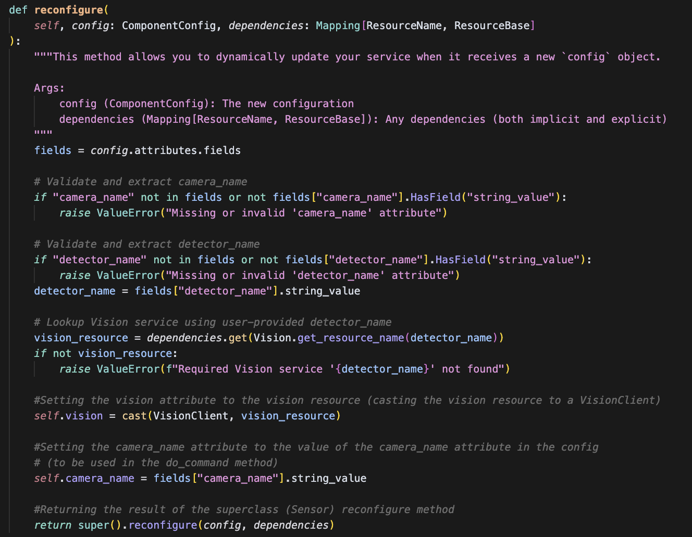
Task 3: Modular Registry: Implement the Component API
reconfigure():
Triggered when the component’s configuration is updated in the Viam app
Reads the latest camera_name and detector_name value from the incoming config
Retrieves the required dependency detector_name from the dependency map (throws error if not available)
Casts the required dependency as the correct type
Stores vision client and camera name internally as instance variables for use in detection logic in do_command()
Prepares the module for dynamic behavior based on configurable dependency names
Notes:
INSTANCE METHOD
Ensures that the user has provided a camera_name attribute in the JSON config.
If not, it throws a helpful error early.
Takes the configured camera name (e.g., "cam") and stores it in an instance variable.
This value will later be used to query the correct camera when detecting people.
Looks up the required myPeopleDetector Vision service from the dependencies dictionary.
Throws a clear error if it’s not available.
Stores the vision client as self.vision so it can be used later in do_command() and get_readings().
Calls the parent class’s reconfigure() method to handle any internal SDK logic. The dependencies mapping in reconfigure() contains resources as generic ResourceBase types. They aren’t automatically typed as specific client classes.
Vision.get_resource_name(...) constructs the correct lookup key used when the Vision service was configured in Viam.
Retrieving from dependencies gives you a raw ResourceBase object, but in practice it’s an instance of VisionClient. To safely treat it as such, you should cast it to VisionClient. This gives proper type checking and lets you use Vision-specific methods like get_detections_from_camera().

Slide 21
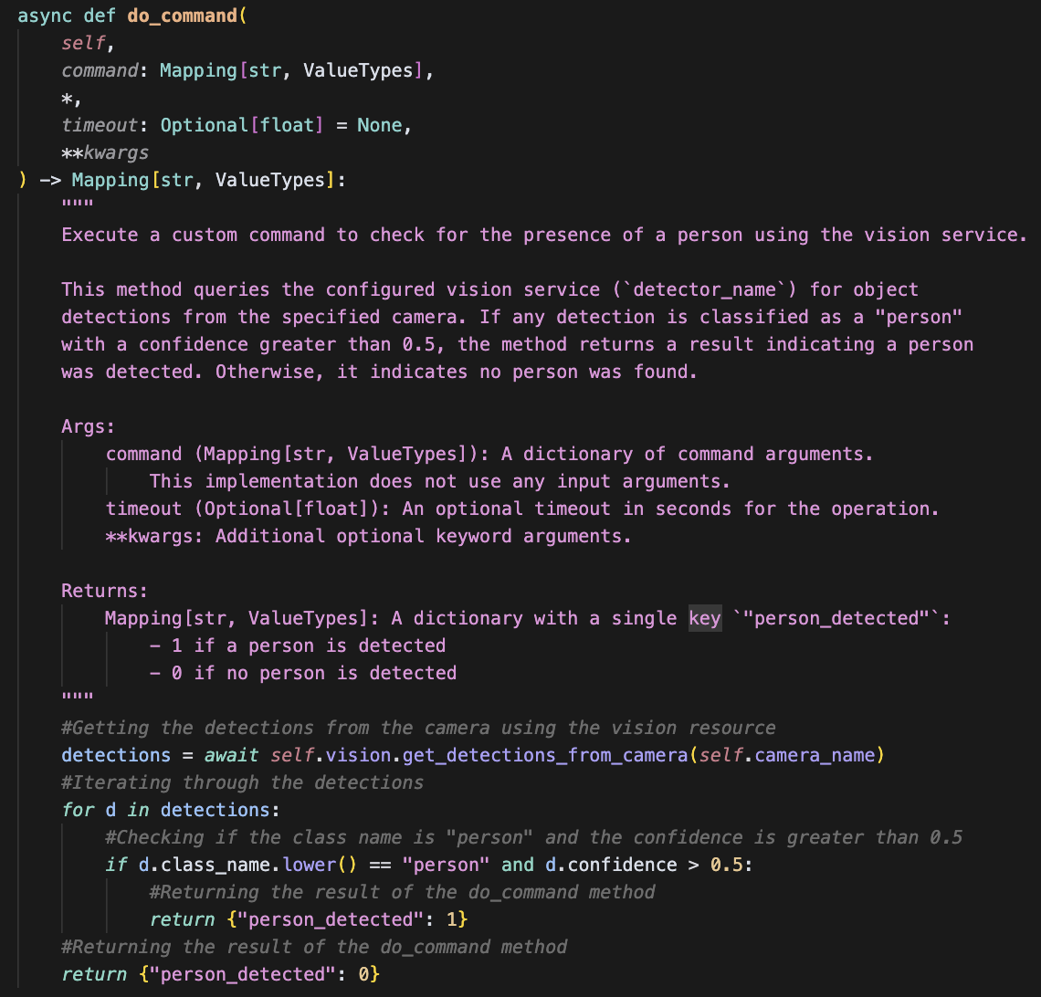
Task 3: Modular Registry: Implement the Component API
do_command():
Allows the sensor to query the `myPeopleDetector` vision service and returns `person_detected: 1` if a person is seen with >0.5 confidence, otherwise 0.
Notes:
The do_command() method implements the core logic for person detection. It is triggered when a custom command is issued to the sensor component.
Specifically, it: Uses the injected VisionClient (myPeopleDetector) to query the camera (specified via camera_name) for detected objects.
Iterates through the detections and checks for any objects with the class "person" and confidence > 0.5.
Returns a simple dictionary result: { "person_detected": 1 } if a person is found.
{ "person_detected": 0 } if no person is detected.
This method powers both real-time detections and supports Viam’s get_readings() sensor API through internal calls.

Slide 22
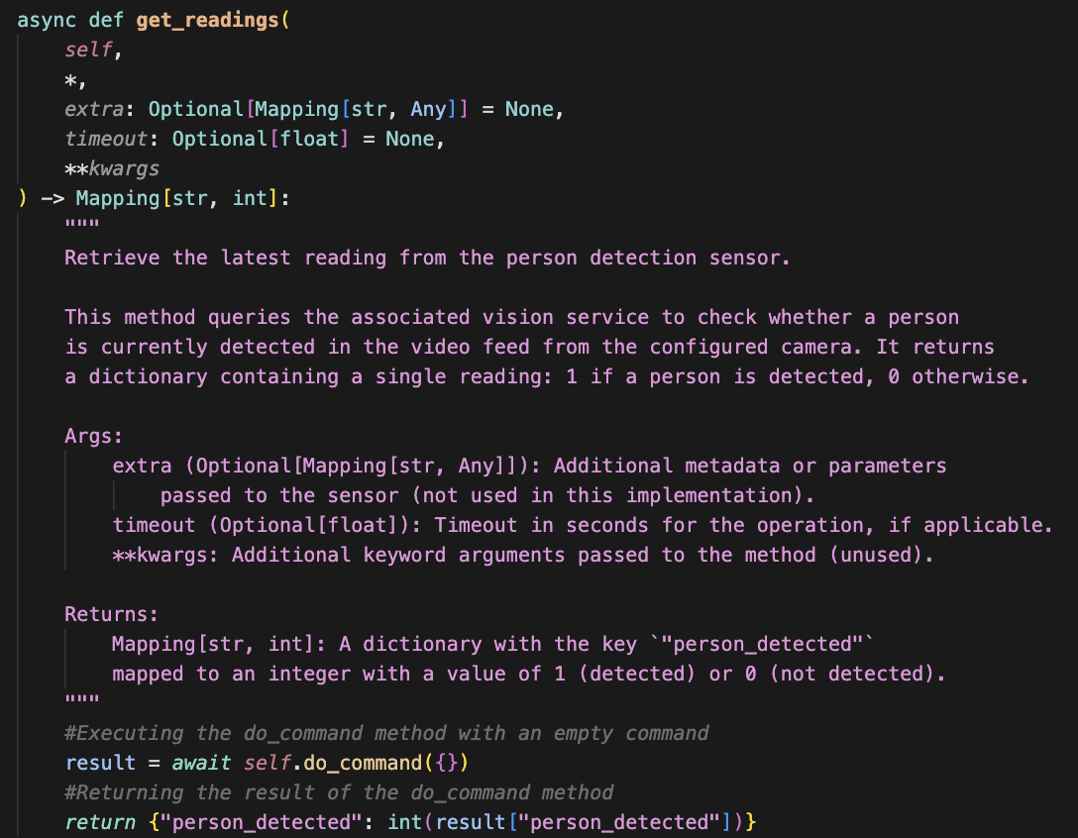
Task 3: Modular Registry: Implement the Component API
get_readings():
sensor interface that Viam calls to retrieve the latest data from the sensor.
Invokes the internal do_command method to perform the actual person detection logic.
Wraps the result from do_command in a dictionary with a consistent key:
Returns: {"person_detected": 1} if a person is detected, Returns: {"person_detected": 0} if no person is detected.
This method ensures compatibility with the Viam Sensor API, allowing the module to be used like any other built-in Viam sensor.
Notes:
The get_readings() method is the public-facing sensor interface that Viam calls to retrieve the latest data from the sensor.
Specifically, it: Invokes the internal do_command() method to perform the actual person detection logic.
Wraps the result from do_command() in a dictionary with a consistent sensor reading key: Returns: { "person_detected": 1 } if a person is detected.
Returns: { "person_detected": 0 } if no person is detected.
This method ensures compatibility with the Viam Sensor API, allowing the module to be used like any other built-in Viam sensor.

Slide 23
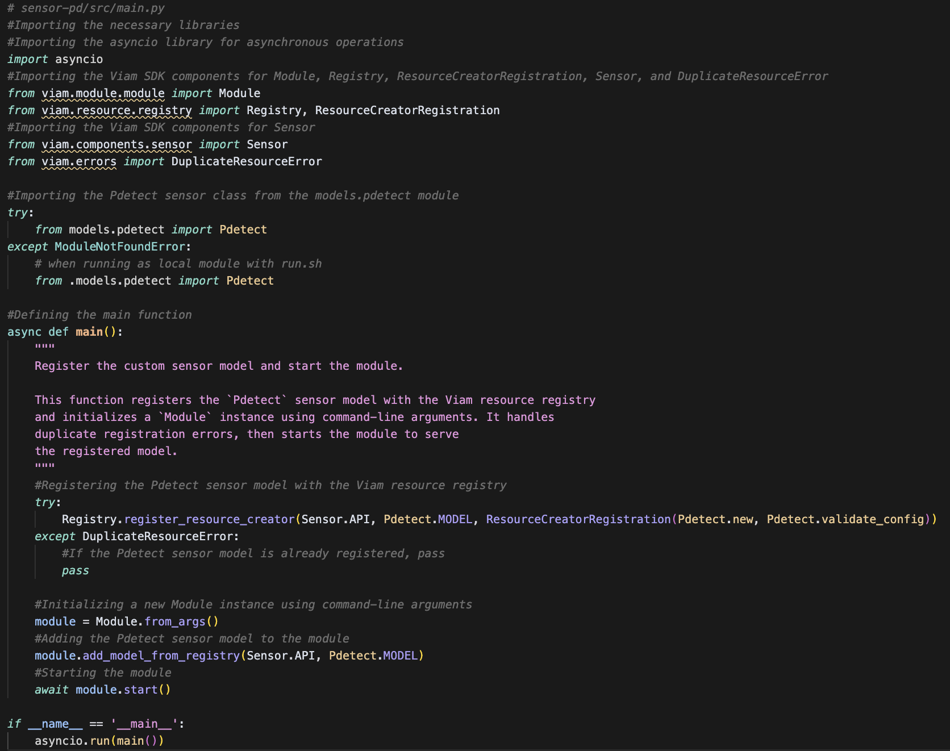
Task 3: Modular Registry: Implement the Component API
main.py:
Uses Viam’s registry to register the pdetect model under the Sensor API, linking the model name (dl-org:sensor-pd:pdetect) to my Pdetect implementation.
Includes error handling to avoid duplicate registration when hot reloading.
Attaches the registered model to the module so it can be discovered and used by Viam.
Initializes and launches the module to connect with the Viam cloud, enabling remote control and configuration.
Notes:
The main.py script is the entry point for the sensor-pd module.
It performs three core functions:
Registers the custom model: Uses Viam’s registry to register the pdetect model under the Sensor API, linking the model name (dl-org:sensor-pd:pdetect) to your Pdetect implementation. Includes error handling to avoid duplicate registration when hot reloading.
Adds the model to the module: Attaches the registered model to the module so it can be discovered and used by the Viam RDK.
Starts the module runtime: Initializes and launches the module to connect with the Viam cloud, enabling remote control and configuration.

Slide 24
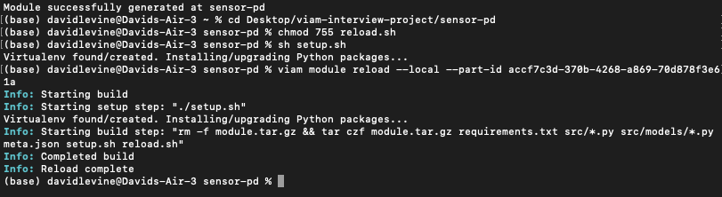
Task 3: Modular Registry: Local Testing
Goal: Test my custom module locally.
Steps to configure my local module on my machine
Notes:
🛠️ Prepare to Run Your Module (Local Dev Setup)
Create a reload.sh Script
This script ensures your module restarts properly during development.
It activates your Python virtual environment and runs main.py.
Make reload.sh Executable
chmod 755 reload.sh
Create Your Virtual Environment
Run the provided setup.sh script to create a .venv and install dependencies.
setup.sh
Update meta.json
Set "entrypoint" to "reload.sh"
Configure "build" to include setup.sh, your Python files, and supported platforms like "darwin/arm64"
This tells Viam how to package and run your module. 🧩 Configure Your Local Module on a Machine
Push Your Module to Viam
Run the hot reload command:
viam module reload --local --part-id <YOUR_PART_ID>

Slide 25
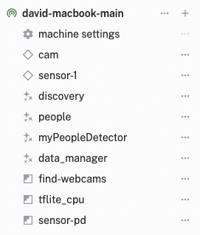
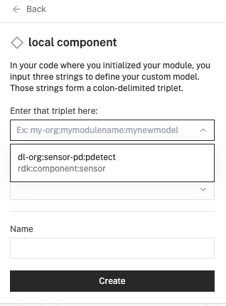
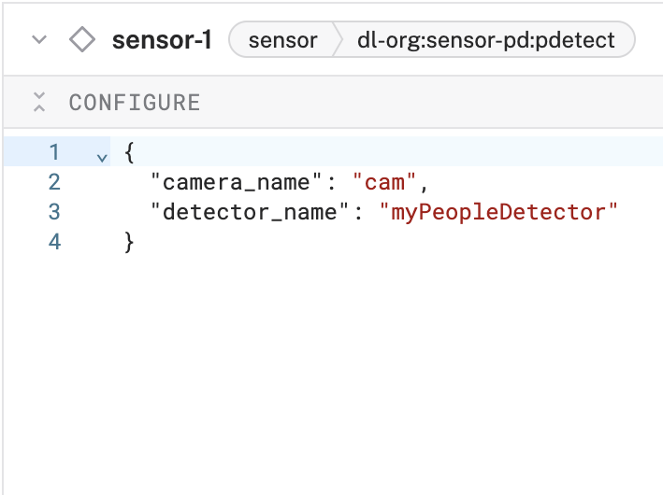
Task 3: Modular Registry: Adding & Testing the Sensor Component
Goal: Add my custom sensor component in the Viam UI.
Notes:
Add the Module in the Viam App
Go to your machine in the Viam web UI.
Click Add Resource ➜ choose Local Module ➜ Local Component.
Enter the Model Triplet
Example: dl-org:sensor-pd:pdetect
Select the appropriate API type (like Sensor).
Set a Name for Your Component
Example: sensor-1
Configure Attributes
Provide any required attributes in JSON format.
Example:
“camera_name”: “cam”

Slide 26
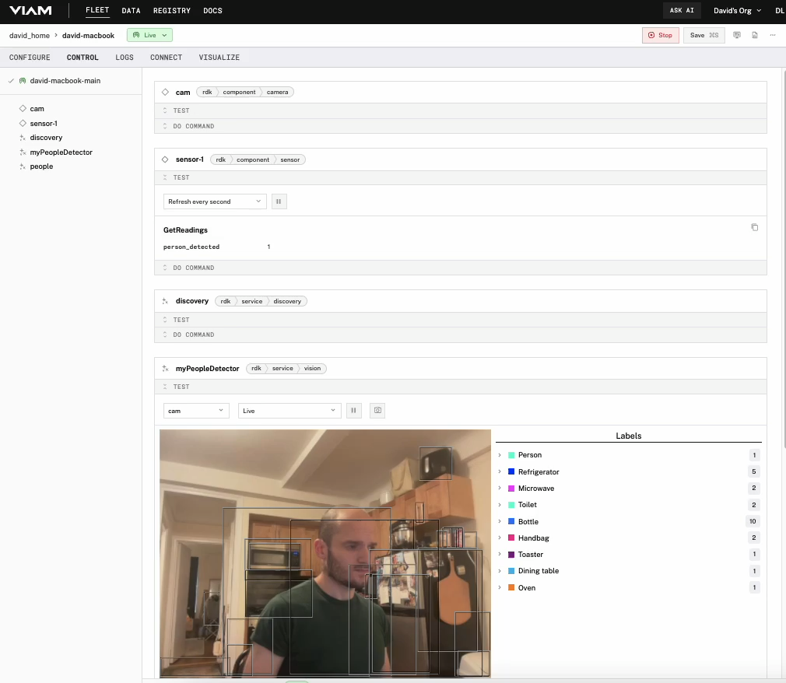
Task 3: Modular Registry: Adding & Testing the Sensor Component
Goal: Test my custom sensor component in the Viam UI.

Slide 27
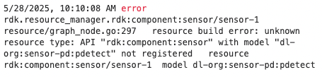
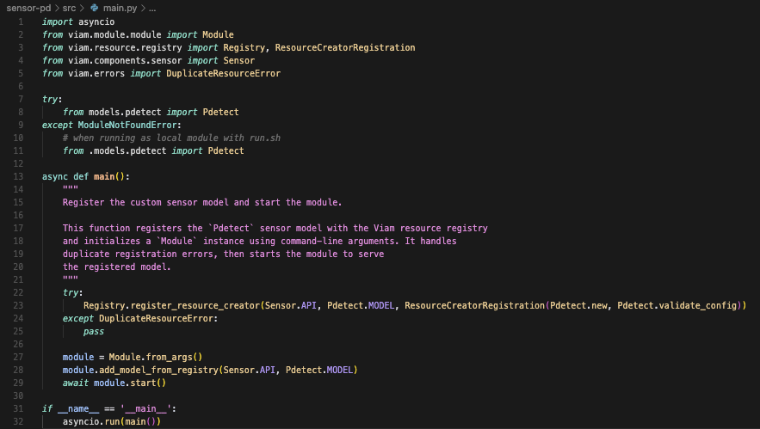
Task 3: Modular Registry: Error Handling
Goal: Find errors and fix bugs to complete Task 3.
Errors: DuplicateResourceError: Cannot add resource with duplicate name "rdk:component:sensor/dl-org:sensor-pd:pdetect” → caused registration error (below)
Cause:
The module attempted to register the same resource more than once during hot reloads.
Fix (main.py):
Wrapped the registration line in a try/except block to catch and suppress the DuplicateResourceError.
Before fix:
After fix:
Registration error caused by duplicate registration
try/except block to catch and suppress the DuplicateResourceError
Notes:
To prevent a DuplicateResourceError when reloading the module locally, I added a try/except block around the model registration step:
This catches the error that occurs when the module is hot-reloaded and the pdetect model has already been registered. Without this block, the module would crash and fail to start, resulting in the message:
“API ‘rdk:component:sensor’ with model ‘dl-org:sensor-pd:pdetect’ not registered”
By gracefully handling the exception, the module can safely restart without trying to re-register an already existing resource, allowing seamless local development and testing.
Error Handling: Duplicate Resource Error
Issue: “API with model not registered” even though model was implemented.
Root cause: module crashed on reload due to duplicate registration.
Fix: Wrapped Registry.register_resource_creator in a try/except block.
Outcome: Prevented crashes, enabled consistent hot reload behavior.
Takeaway: Defensive coding around registration improves module stability and UX during development.

Slide 28
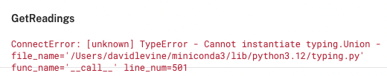
Task 3: Modular Registry: Error Handling
Goal: Find errors and fix bugs to complete Task 3.
Error: TypeError - Cannot instantiate typing.Union
Cause:
Attempted to wrap a basic type (int) inside SensorReading, which isn’t necessary and led to incompatible typing. (SensorReading is a type alias)
Fix (pdetect.py → get_readings() method):
Removed the use of SensorReading()and returned a plain int instead.
Before fix:
return {"person_detected": SensorReading(int(result["person_detected"]))}
After fix:
return {"person_detected": int(result["person_detected"])}
Type Error found in sensor_1 log
Removed the use of SensorReading()
Notes:
My thinking was:
Since get_readings() should return a dictionary of sensor values, I assumed that each value should be a SensorReading object.
I tried to wrap the result of my do_command() call with SensorReading(...), assuming it was the correct format for Viam’s sensor API. return {"person_detected": SensorReading(int(result["person_detected"]))}
This error meant:
I was calling SensorReading(...), but SensorReading was not a class or constructor, and not meant to be instantiated directly.
In the Viam Python SDK, SensorReading is a typing alias, often defined like this:
SensorReading = Mapping[str, ValueTypes]
ValueTypes = Union[str, float, bool, int, list, dict, None]
I initially misunderstood SensorReading as a class or constructor and tried to cast a value to it. But SensorReading is just a type alias for Mapping[str, ValueTypes], so the correct way to satisfy the return type was to return a plain dictionary in that shape.
You can’t instantiate Union like a class — so this line failed because I was doing:
SensorReading(1) # ❌ This is invalid Instead of trying to create a SensorReading object, I just returned a regular dictionary of key-value pairs using native types (int, str, etc.), like this:
return {"person_detected": int(result["person_detected"])} This worked perfectly because Viam expects get_readings() to return a dictionary with native types — not custom class wrappers. Viam’s SensorReading is not a class — it’s a type alias.
Type annotations in Python (like Mapping[str, int]) are for static checking, not runtime behavior.
You can’t instantiate typing aliases like Union, Mapping, or Tuple directly.
When in doubt, stick with standard Python types (int, str, float) unless you know the SDK needs something special.

Slide 29
Upload Module to Viam Registry
1. Create a GitHub repo & update meta.json.
Ensure the entrypoint, build, path, and supported arch values are set correctly (back to original).
This file tells Viam how to build, package, and run the module.
2. Upload your module.
Push the module to the registry using PyInstaller.
3. Use the module in the cloud.
Follow the guide here.

Slide 30
Potential Next Steps
Customizable Configuration via Viam UI
Support configurable confidence thresholds, detection classes (add class_filter, min_confidence to config)
Log detection scores at the debug level to tune thresholds based on field behavior.
Capture & Store Data with Viam
Extend to support other ML models beyond people detection in the Vision service.
Integrate with Viam’s Data Capture UI to view and download results.
Build a UI for Sensor Control
Develop a lightweight frontend to:
Display live detection results from get_readings.
Visualize logs and sensor state.
Robust Error Handling
Add better exception management, validation, and user-visible error messages.
Add timeout support (do_command), add retries (if Vision service is unavailable).
Developer Experience & Docs
Publish module to Viam Registry.
Include links to my GitHub, Docs, and example meta.json in the Registry.
Notes:
I’d extend the configuration schema to accept additional attributes like class_filter and min_confidence. Then, in validate_config(), I’d validate those fields, and in do_command(), I’d loop through the filtered class names and apply the configurable confidence threshold. This would turn the module into a general-purpose object detection sensor, capable of detecting any class — not just “person” — with fine-tuned sensitivity per use case.
There are a few improvements I’d make: Add timeout support to all async calls using the timeout kwarg passed to do_command() and get_detections_from_camera().
Add retries in case the Vision service is temporarily unavailable.
Log detection confidence scores at debug level so we can tune thresholds based on field behavior.
Handle empty or null responses gracefully — returning a default instead of raising exceptions that could crash the module.
Make min_confidence and class_filter configurable. That lets operators adapt the module to different environments — for example, tuning for “car” in a parking lot or “animal” on a farm.
Use the Data Capture service to log detection events. This opens the door to building alerts, trend graphs, or even training datasets for a custom ML model later.
Extending the config to class_name & min_confidence @classmethod
def validate_config(
cls, config: ComponentConfig
) -> Tuple[Sequence[str], Sequence[str]]:
required_fields = ["camera_name", "detector_name"]
for field in required_fields:
if field not in config.attributes.fields or not config.attributes.fields[field].HasField("string_value"):
raise Exception(f"Missing or invalid attribute: {field}")
# Optional: class_filter (list of strings)
if "class_filter" in config.attributes.fields:
if not config.attributes.fields["class_filter"].HasField("list_value"):
raise Exception("class_filter must be a list of strings")
# Optional: min_confidence (float)
if "min_confidence" in config.attributes.fields:
if not config.attributes.fields["min_confidence"].HasField("number_value"):
raise Exception("min_confidence must be a number")
detector_name = config.attributes.fields["detector_name"].string_value
return [detector_name], []
In reconfigure(): fields = config.attributes.fields
self.class_filter = None
if "class_filter" in fields:
self.class_filter = [v.string_value.lower() for v in fields["class_filter"].list_value.values]
self.min_confidence = 0.5 # default
if "min_confidence" in fields:
self.min_confidence = fields["min_confidence"].number_value
In do_command:
for d in detections:
if (self.class_filter is None or d.class_name.lower() in self.class_filter) and d.confidence > self.min_confidence:
return {"person_detected": 1}
return {"person_detected": 0} Example JSON: {
"camera_name": "cam",
"detector_name": "myPeopleDetector",
"class_filter": [
{ "string_value": "person" },
{ "string_value": "dog" }
],
"min_confidence": { "number_value": 0.65 }
} TIMEOUTS import asyncio
from asyncio.exceptions import TimeoutError
async def do_command(
self,
command: Mapping[str, ValueTypes],
*,
timeout: Optional[float] = 3.0, # default timeout in seconds
**kwargs
) -> Mapping[str, ValueTypes]:
retries = 3
for attempt in range(retries):
try:
detections = await asyncio.wait_for(
self.vision.get_detections_from_camera(self.camera_name),
timeout=timeout
)
for d in detections:
if (self.class_filter is None or d.class_name.lower() in self.class_filter) and d.confidence > self.min_confidence:
return {"person_detected": 1}
return {"person_detected": 0}
except TimeoutError:
if attempt < retries - 1:
await asyncio.sleep(0.2) # backoff
continue
else:
return {"error": True, "message": "Vision service timeout"}
except Exception as e:
return {"error": True, "message": str(e)}
Wrapped Vision service call in asyncio.wait_for()
Retries up to 3 times on timeout
Returns a fallback result on failure
Why Timeouts?
Prevent system hangs: If a service (like Vision) stalls, the module could hang forever without a timeout.
Ensure responsiveness: The rest of your robot shouldn’t wait indefinitely.
Fail fast & recover: Timeouts help detect issues early and trigger retries, fallbacks, or alerts.
Why Retries?
Handle transient errors: Networks drop, cameras glitch — retrying once often fixes it.
Improves reliability: Instead of failing immediately, the module gives itself a second chance.
Graceful degradation: If all retries fail, you can return "error": true and keep the system running safely.

Slide 31
Conclusions
Task 1: Vision
Configured a basic camera component and use Viam’s vision service to implement a simple object detector
Task 2: Cloud Integration
Configured Viam’s data capture service to store camera frames into the cloud
Described use cases for custom models
Task 3: Modular Registry
Created a custom vision-based detection module using Viam’s Python SDK
Registered and deployed on a real robot
Validated config, managed dependencies, and handled real-time camera input
Explained how to deploy, configure, and debug the module via the Viam app
Documented and tested configurable parameters (camera, detector, thresholds)
Future Extensions
Add retries, logging, and advanced config options
Generalize for multi-class detection
Integrate with Data Capture for real customer workflows

